Slide 1
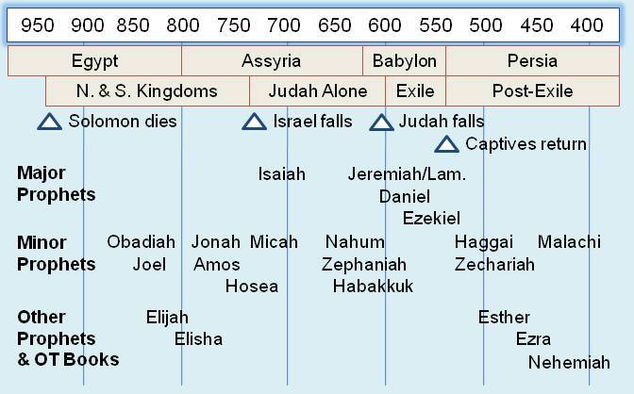

Slide 3
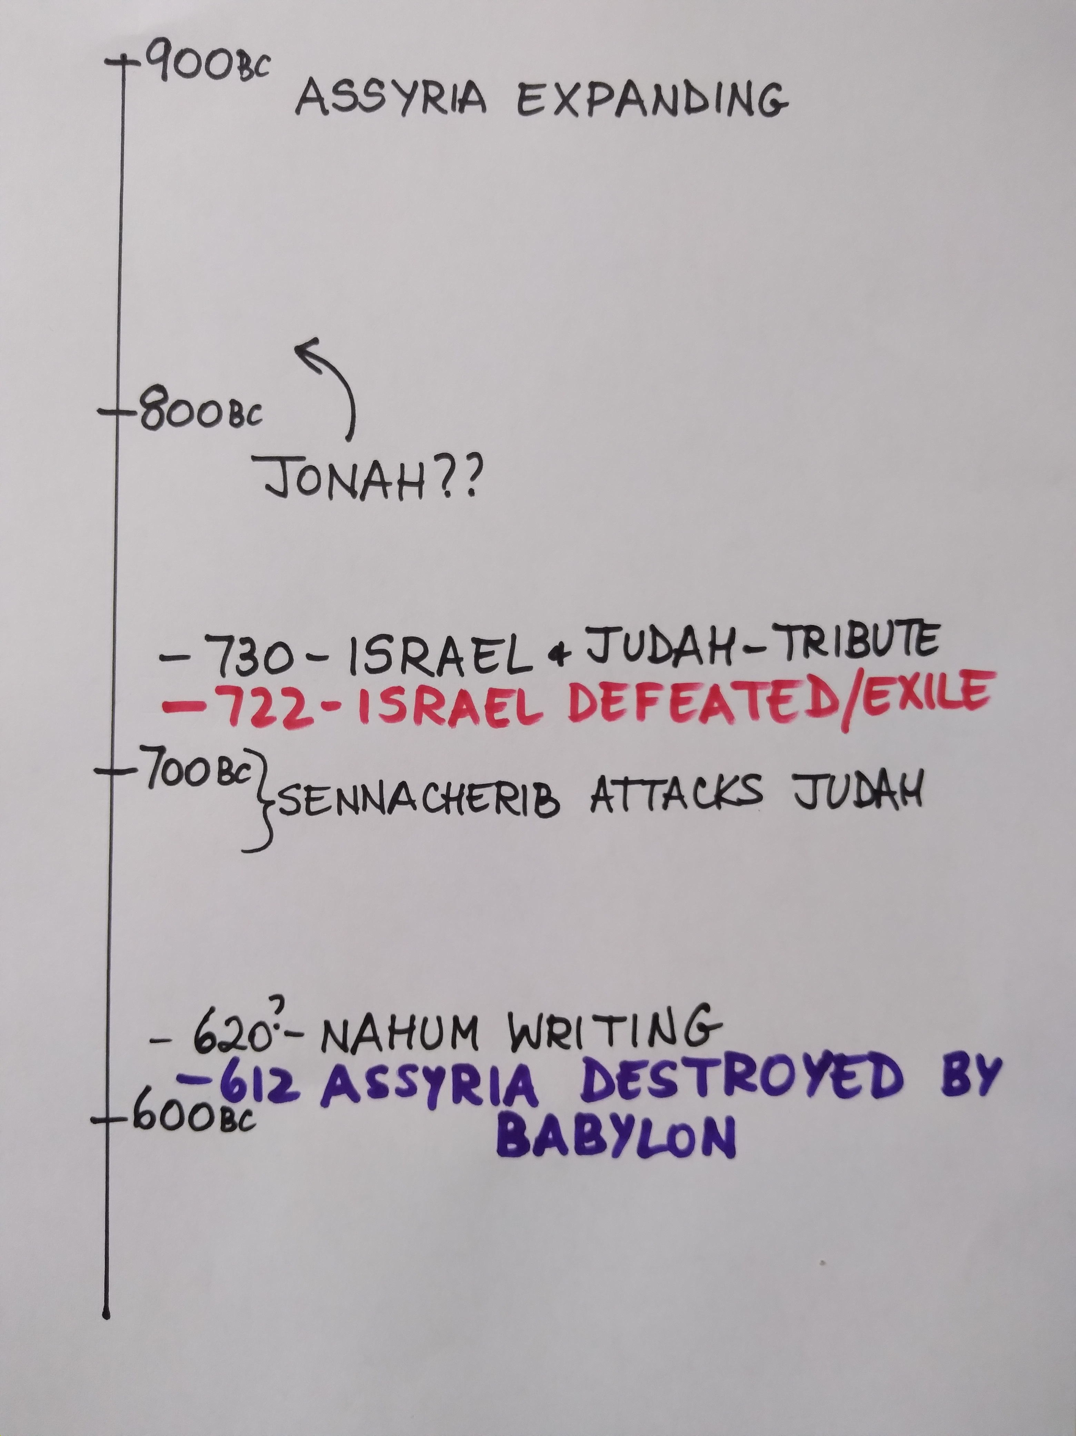

Slide 4
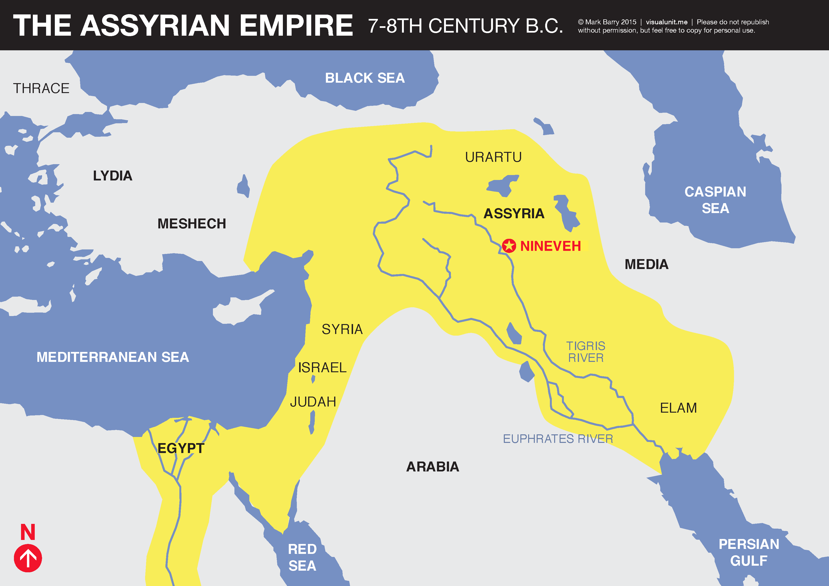

Slide 6
God’s actions (v.4-6)

Slide 8
Proclamation of God’s victory (v. 8-14)

Slide 10
A Final word (v.14)

